Slide 1
Heat Transfer
Chapter 2

Slide 2
Steady State Conduction: 1D
Cylindrical and Spherical System fall into one dimensional system when temperature in the body is a function of radial system only and independent of axial distance.
The Plane Wall
Appling Fourier’s Law of conduction:
Here, thermal conductivity is considered constant. If it is depended on temperature by following equation:
T₁
q
T₂

Slide 3
Steady State Conduction: 1D
One dimensional Conduction in Multilayer Material:
At Steady State Condition: Fourier’s law of Conduction
T₁
T₂
q
T₃
q
T₄
1
2
3
4

Slide 4
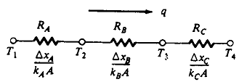
Steady State Conduction: 1D
Solving the above equation simultaneously, overall Heat Flow can be written as:
T₁
T₂
q
T₃
q
T₄
1
2
3
4

Slide 5
Steady State Conduction: 1D
Series of parallel one dimension heat transfer through composite wall:
D
F
A
C
E
E
B

Slide 6
Steady State Conduction: 1D
Radial System:
For a cylinder with length sufficiently large enough compared to diameter, so heat flows in radial direction only.
Fourier’s law of conduction:
q
r
r_{i}
r_{o}
L
Boundary Conditions: at r = r_{i} T = T_{i}
at r = r_{o} T = T_{o}

Slide 7
Steady State Conduction: 1D
Solution of the above equation:
Thermal Resistance:
q
r
r_{i}
r_{o}
L

Slide 8
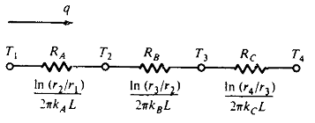
Steady State Conduction: 1D
Overall heat flow:
r₁
r₂
r₄
r₃

Slide 9
Steady State Conduction: 1D
For Spherical System:
Area, A = 4πr²
q_{r} = - k 4πr²
r_{i}
After solving above equation:
r_{o}

Slide 10
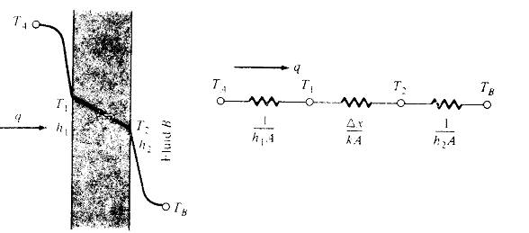
Steady State Conduction: 1D
Overall Heat Transfer Coefficient:
Heat transfer is expressed by:

Slide 11
Steady State Conduction: 1D
Overall heat transfer is calculated as the ratio of overall temperature difference and sum of the thermal resistance.
Overall heat transfer due to conduction and convection is usually expressed in term of overall heat transfer co-efficient U.
q = UAΔT_{overall}
So,

Slide 12
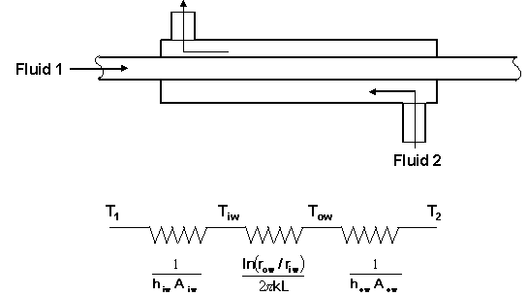
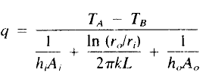
Steady State Conduction: 1D
Overall heat transfer co- efficient: For hollow Cylinder
At steady state condition:

Slide 13
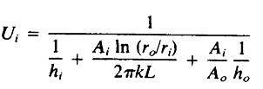
Steady State Conduction: 1D
Overall heat transfer coefficient based on inside area:
Overall heat transfer coefficient based on outside area:

Slide 14
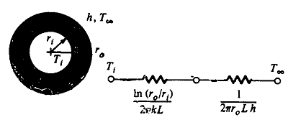
Steady State Conduction: 1D
Critical Thickness of Insulation:
Adding more and more insulation will decrease the conduction heat transfer rate. However, increasing the insulation thickness will increase the convection heat transfer rate by increasing the heat transfer surface area. There exist a insulation thickness that will minimize the overall heat transfer rate and that insulation thickness is called Critical thickness of Insulation.
Assumptions:
Steady state condition.
One dimensional heat
transfer in radial direction.

Slide 15
Steady State Conduction: 1D
3. Negligible wall thermal resistance.
4. Constant properties of insulation.
5. Negligible radiation exchange between the wall and surrounding.
Overall Heat transfer,
Resistance,
Optimum insulation thickness will associated with the value of r that minimize heat transfer q.

Slide 16
Steady State Conduction: 1D
So, for minimum heat transfer:
At , the value of
So, Critical Thickness,

